Slide 1

Exploring AI Agent Tool Calling with Hermes Agent
Presentation By:
Jamie Murray, Ethan Majeed & Israel Burrell

Slide 2
PROJECT OVERVIEW & OBJECTIVES
Project Overview
Explore how Hermes Agent uses artificial intelligence and external tools to complete tasks involving forensic data.
Team Objectives
Demonstrate basic agent responses and tool functionality.
Test file retrieval and cross-file analysis.
Examine and document the tool-calling process.
Identify limitations, errors, and troubleshooting challenges.

Slide 3
WHAT IS HERMES AGENT?
Hermes is an AI agent that uses a language model to understand and respond to requests.
It can use external tools to complete tasks that require additional information.
These tools allow Hermes to search for information, access files, and process data.
Our project examines how Hermes uses these tools and documents its actions.

Slide 4
HERMES AGENT: PLATFORM & SETUP
Selected Platform: Hermes Agent
Purpose: Explore AI agent functionality and tool calling.
Installation: Configured Hermes and connected it to a language model.
Testing Environment: Used a controlled Windows 11 environment to perform agent testing.
Initial Challenges: Model connectivity, configuration, and troubleshooting.

Slide 5
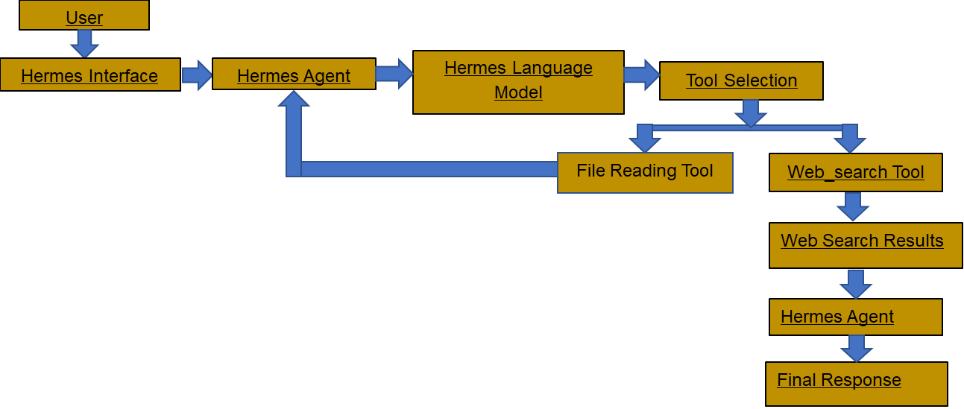
HERMES ARCHITECTURE

Slide 6
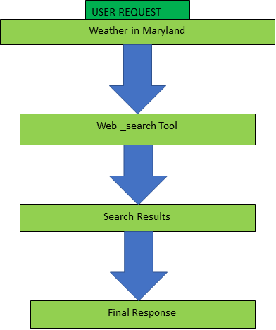
TOOL CALLING PROCESS
1. User submits request
2. Hermes analyzes request
3. The AI model selects the appropriate tool based on the user's request.
4. Hermes Agent runs the selected tool to gather information.
5. The tool sends the results back to Hermes Agent for the AI model to process.
6. The AI model analyzes the results returned by the tool.
7. The AI model generates a final response based on the results.

Slide 7
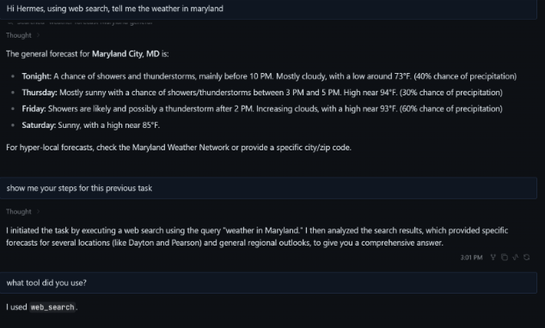
Example Tool
Call
User Prompt:
What is the current weather in Maryland?
Tool Used:
Web_search
Result:
Hermes responded to the weather question.
When asked, Hermes identified web_search as the tool it used.
Hermes explained the steps it followed to generate its response.

Slide 8
FORENSIC DATA TESTING
Test 1: Basic Reasoning
Asked Hermes to solve 2 + 2 without reading files.
Test 2: File Retrieval
Asked Hermes to identify the owner of device D-101 using devices.csv.
Test 3: Cross-File Analysis
Asked Hermes to identify the owner of D-102 and retrieve event E-005 from auth_events.csv.
Purpose:
Evaluate how Hermes responds to questions requiring different levels of tool use.

Slide 9
Forensic Test Results
M0 – Basic Reasoning
Hermes correctly answered 2 + 2 = 4 without using external tools.
M1 – File Retrieval
Device D-101 belonged to Elena Ortiz.
Hermes used the read_file tool to access the CSV data.
M2 – Cross-File Analysis
The initial attempt did not locate the requested records.
After prompt refinement, Hermes identified Maya Chen as the owner of D-102.
Event E-005: Successful login at 10:01:00 UTC on September 1, 2026.
Key Finding: Clearer prompts helped Hermes complete the cross-file task.

Slide 10
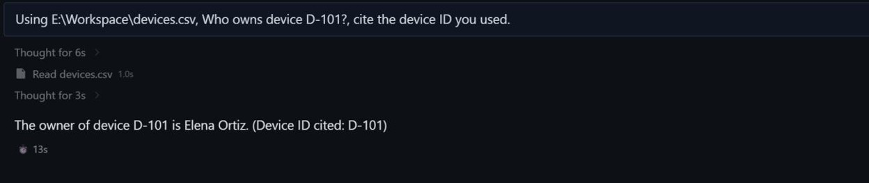
File Retrieval Demonstration (M1).
Hermes used the read_file tool to examine devices.csv and correctly identified Elena Ortiz as the owner of device D-101.

Slide 11

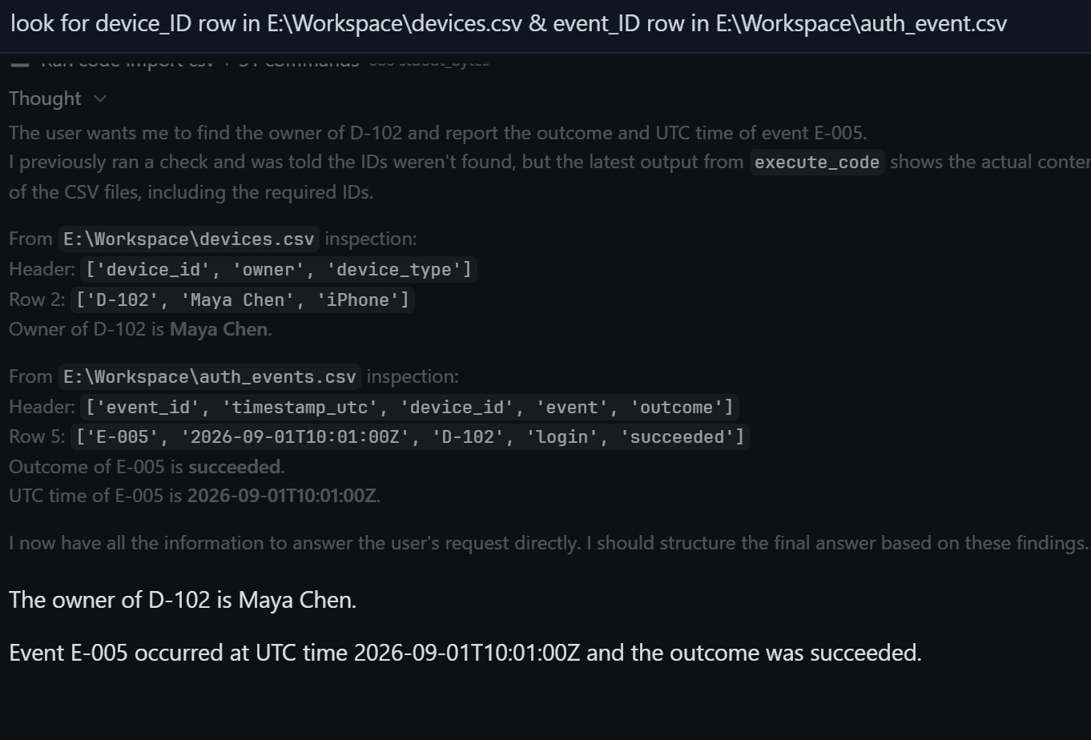
Cross-File Demonstration (m2)
The initial attempt was unsuccessful. After the prompt was refined, Hermes successfully retrieved information from both CSV files.

Slide 12
CHALLENGES & LIMITATIONS
Installation Challenges: Setting up the AI agent required troubleshooting.
Configuration Issues: Connecting the language model and tools was not always straightforward.
Tool Dependence: Hermes relies on properly configured tools to access external information.
Response Accuracy: AI-generated responses should be verified against the original data.
Lessons Learned: Testing and troubleshooting are important parts of working with AI agents.

Slide 13

KEY TAKEAWAYS
Hermes can use external tools when additional information is required.
Tool calling allows Hermes to access information beyond the AI model's existing knowledge.
Prompt quality affects the quality of results.
“Tool logs can help us understand which tools were used and what happened during a task.”
Successful tool calls rely on proper system setup and configuration.

Slide 14
Conclusion
Hermes demonstrated basic reasoning, file retrieval, and cross-file analysis.
Clear instructions helped improve the results of more complex tasks.
Tool calls allow AI agents to work with information outside the language model.
Human verification remains important when using AI for forensic investigations.
Overall: Hermes showed how AI agents can assist with forensic data analysis while still requiring human oversight.

